Slide 1
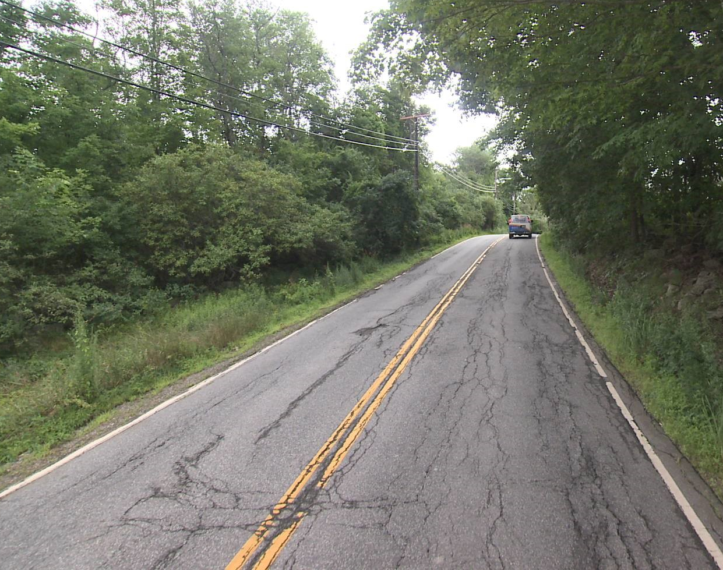
Using CFI and CTI to Support Decision-Making Regarding Seasonal Loading
Brian Burne & Cliff Curtis Highway Maintenance
February 12, 2021

Slide 2
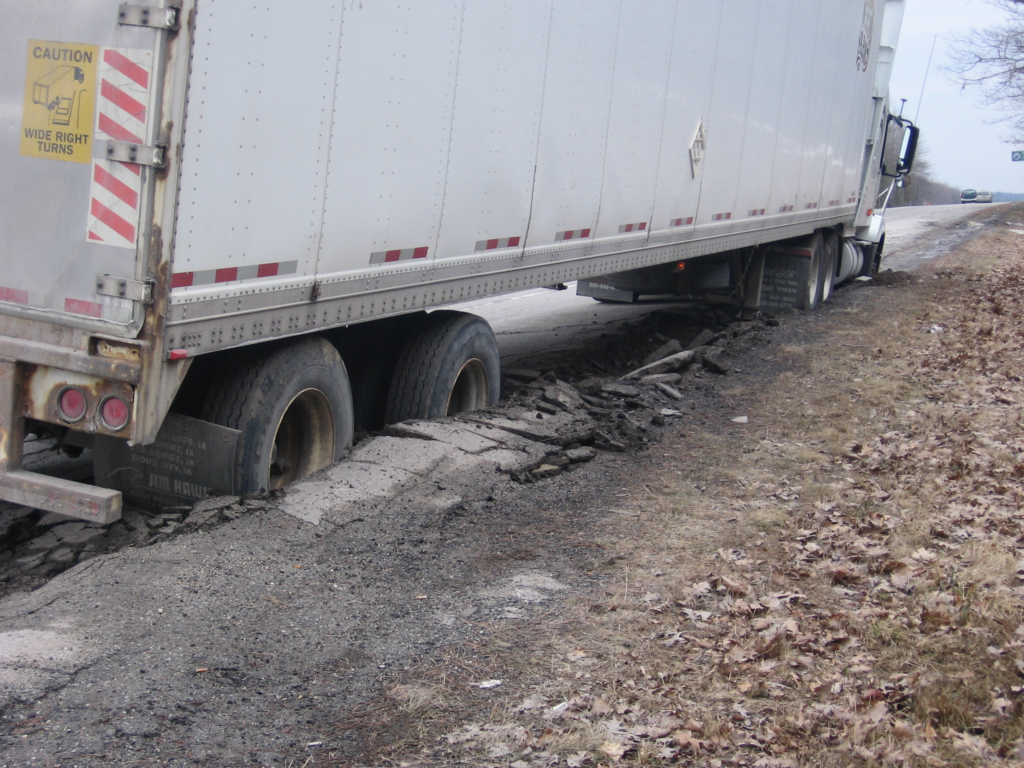
Why is this Important?
In seasonal frost areas, as freezing occurs the road becomes stiffer and stronger. Many state Departments of Transportation take advantage of the period of higher strength in mid-winter by applying winter weight premiums (WWPs), increasing the allowable weight that trucks can haul.
During late winter and early spring when the top road layers begin thawing and can’t drain excess water, the road is highly susceptible to damage. To reduce roadway damage, many highway agencies apply spring load restrictions (SLR) during the critical time interval when the pavement is most vulnerable to damage.

Slide 3
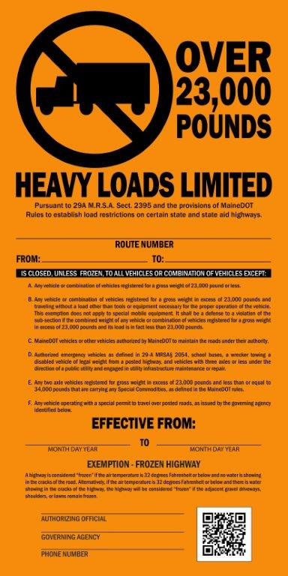
Background
Over the past several years, MaineDOT has had an ongoing research project with the Department of Civil Engineering at the University of Massachusetts, the Infrastructure and Climate Network at UNH (ICNet), and the Northeast Regional Climate Center (NRCC) to develop an inexpensive, consistent and reliable method to anticipate when the soils underneath the highways across the state both freeze in the winter and thaw in the spring. This effort resulted in the Cumulative Freezing Index (CFI) and Cumulative Thawing Index (CTI) maps that are now posted online at the Northeast Regional Climate Center website: http://www.nrcc.cornell.edu/industry/roads/
MaineDOT has found that both the CFI and CTI serve as reasonably reliable indicators that should continue to help initiate consistent field reviews of roads to identify when roads may be deemed “solidly frozen”, when postings should be implemented, or when postings should be lifted.

Slide 4
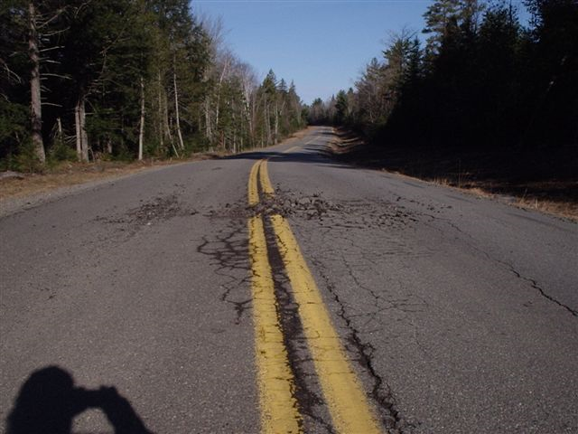
Important Caveat
It is important to recognize that these maps attempt to model freezing and thawing conditions, on average, based upon a 4km grid of actual and forecast air temperatures. Without field instrumentation that can measure and account for the subsurface temperatures on specific sections of highway that may be either fully shaded, fully exposed to sunlight, or some combination thereof, actual field inspection is still required to verify whether Winter Weight Premiums (WWPs) or postings should be implemented or lifted. These maps are simply tools that allow us to better identify the optimal time frames for such inspections.

Slide 5
Website Overview
The Cumulative Freezing Index (CFI) map and the Cumulative Thawing Index (CTI) map are selected on the top right of the web page (indicated by the red arrow). In the fall, this page will default to the CFI map to track the freezing trends heading into winter. The Forecast Days section (indicated by the blue arrow) provides an outlook of how the map will change, based upon the current weather forecasts.

Slide 6
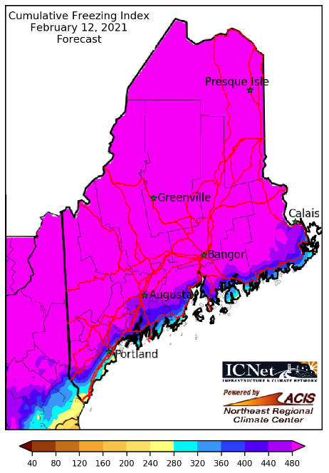
Using the CFI Map
Based on experience established in Minnesota, MnDOT recommends that winter weight premiums (WWP) can be allowed when the 3-day weather forecast indicates that the cumulative freezing index (CFI) will exceed 280°F-days and extended forecasts predict continued freezing temperatures. In other words, when the current CFI map, as well as the forecast CFI maps, are blue or pink, the roads should be sufficiently frozen for WWPs. However, at this time, the use of this CFI map to implement WWPs is not authorized by Maine statutes. Instead, 29-A§2360-A, Exception to axle fines during the midwinter season, states the following:
1. Axle fines waived; midwinter season. The fine is waived and the Violation Summons and Complaint is not issued for violations of axle and axle group weight limits or tolerances provided by sections 2352, 2353, 2354, 2357, 2364 and 2365 for vehicles traveling during the months of January and February.

Slide 7
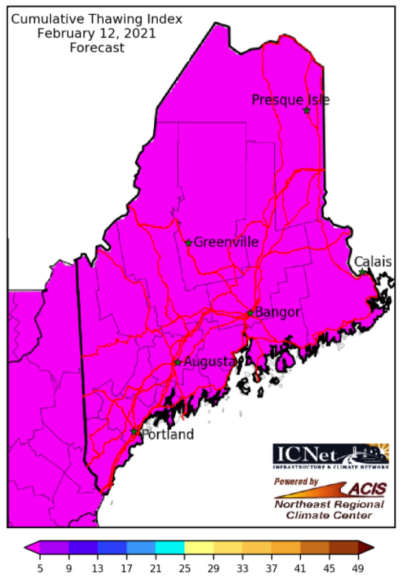
Using the CTI Map (January 1st – April 1st)
Also based on experiences established in Minnesota, MnDOT recommends that the Spring Load Restrictions (SLR) be scheduled when the 3-day weather forecast indicates that the cumulative thawing index (CTI) for a zone will exceed 25°F-days and longer-range forecasts predict continued warmth. The CTI map becomes the default map on the web page as of January 1st each year. The CTI scale will be as shown on the left (5 to 49) to help support the decision-making process to post vulnerable roads as the map turns yellow and brown. On April 1st, the scale will change to the one shown on the following page to help support the decision-making process for lifting the postings.

Slide 8
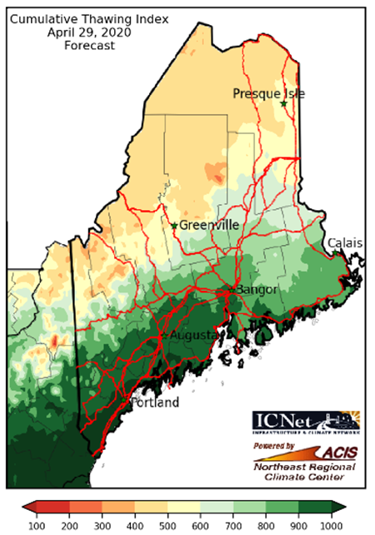
Using the CTI Map (April 1st – Summer)
On April 1st, the CTI scale will change to the one show on the left, which uses a scale ranging from 100 to 1000 and introduces shades of green. Generally speaking, as the map turns light green, roads with better drainage may be ready to have their postings lifted. As the temperatures continue to warm and the shade of green darkens, those roads having poorer drainage will follow.

Slide 9
Comparison Slides from Spring 2020
The following slides indicate how the posted roads during the spring of 2020 changed with the corresponding CTI maps. The following observations were made:
When the CTI reached the 700-800 color band (indicated by light green), most roads had, or were ready to have, their seasonal weight restrictions lifted.
On a few more vulnerable roads, the restrictions were lifted roughly a week later based upon field observations, using evidence of water coming out of cracks in roadway, water in pot holes, soft shoulders, and/or water in ditches.
Notes about the following slides: The map shown on the left is from the CFI/CTI website. The map shown on the right is from MaineDOT’s Posted Roads website. On the MaineDOT map, red indicates the roads that were posted on the dates indicated, while gold indicates the roads that could potentially have been be posted, but were not. It should also be noted that roads in the southeastern part of the state have not typically been posted.

Slide 10
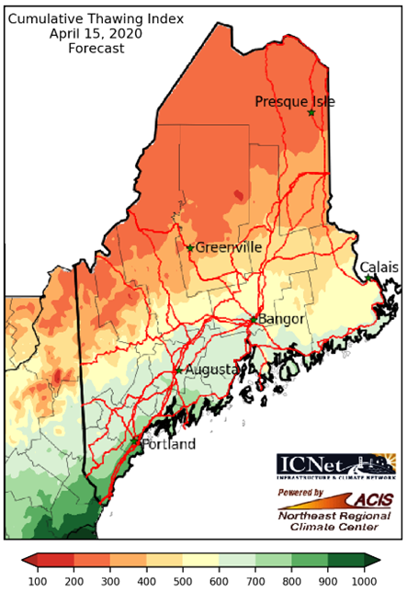
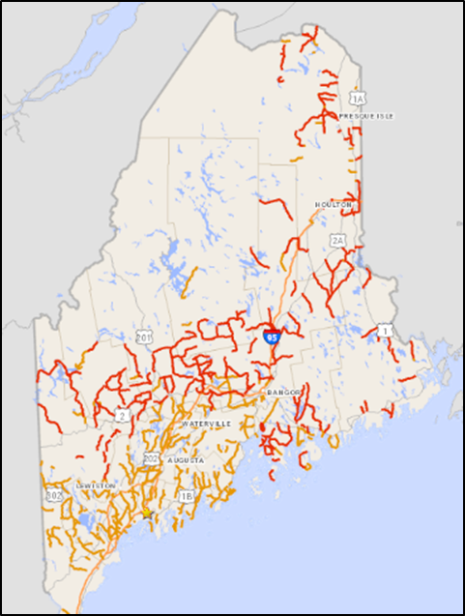
April 15, 2020

Slide 11
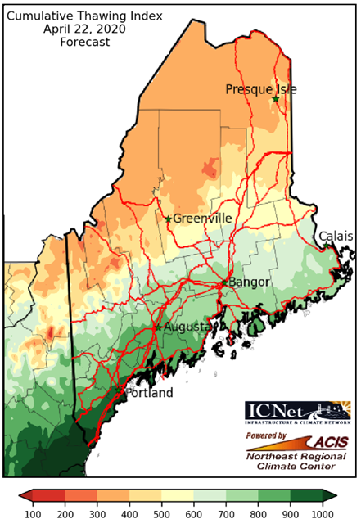
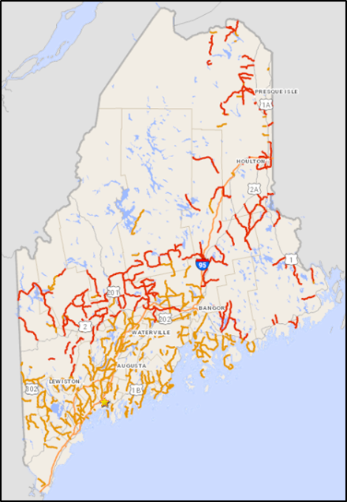
April 22, 2020

Slide 12
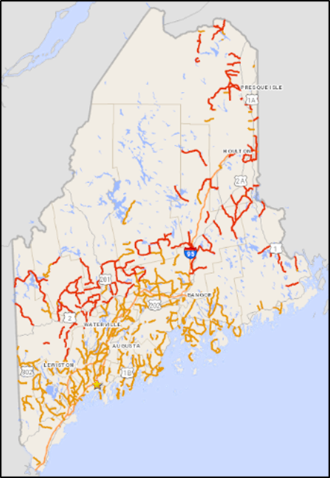
April 29, 2020

Slide 13
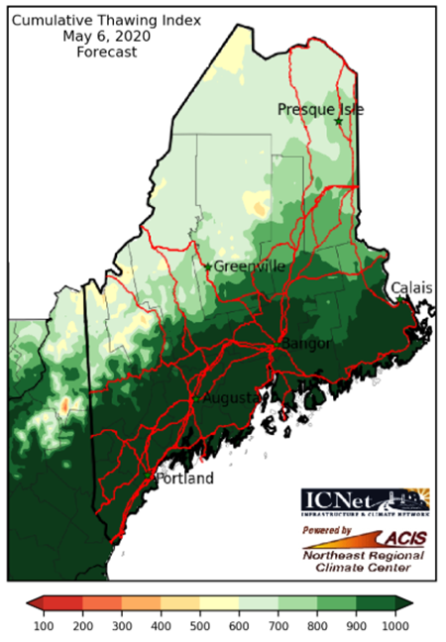
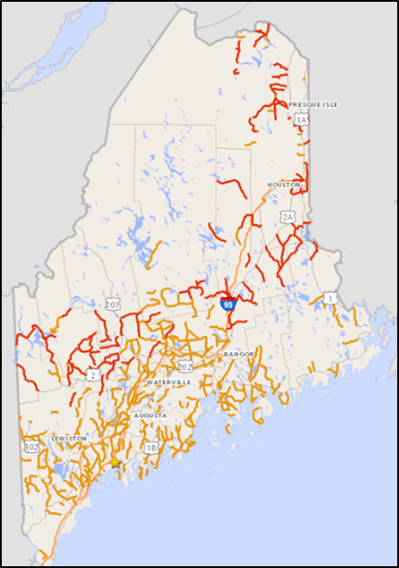
May 6, 2020

Slide 14
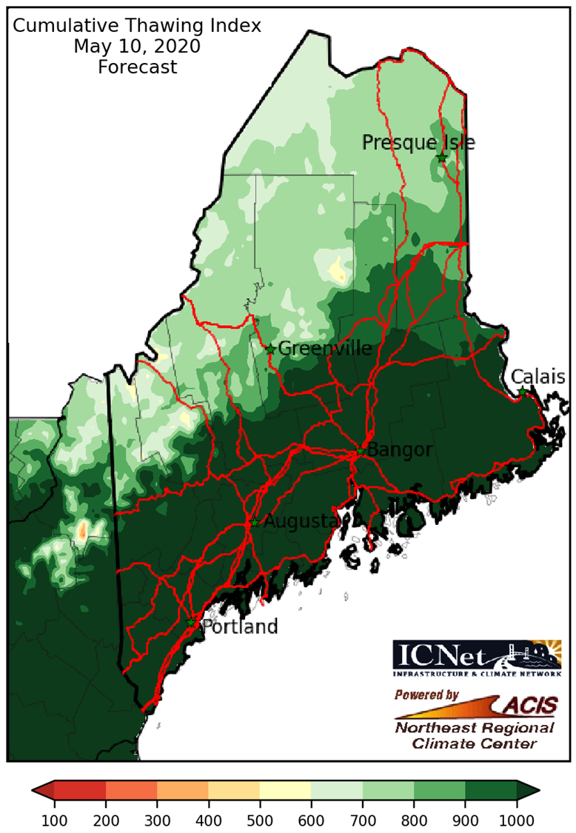
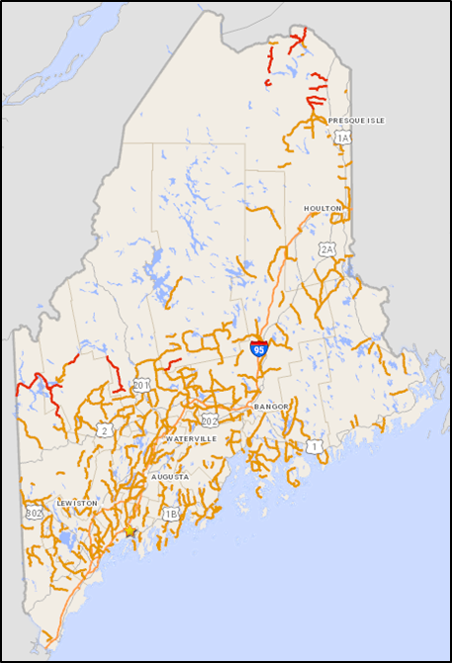
May 10, 2020

Slide 15
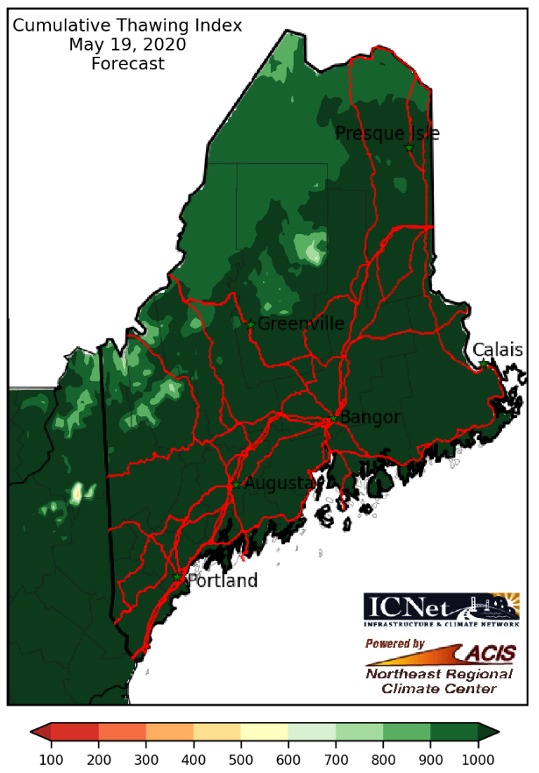
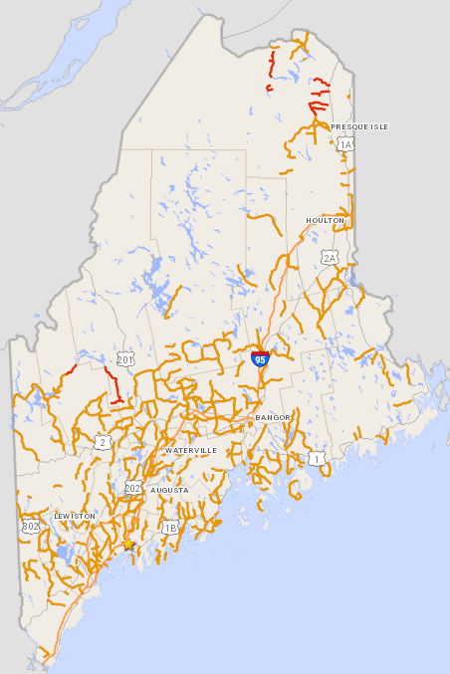
May 19, 2020

Slide 16
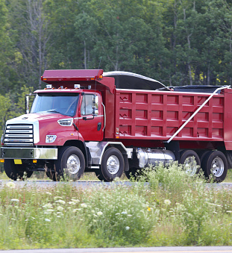
Acknowledgements
MaineDOT would like to express its sincere appreciation to the following individuals for the research and development of these tools:
Heather Miller, Professor, Department of Civil Engineering, UMass Dartmouth
Jennifer Jacobs, Director of the Infrastructure and Climate Network, ICNet, at UNH
Keith Eggleston, Regional Climatologist, Northeast Regional Climate Center
Arthur Degaetano, Professor Earth and Atmospheric Sciences Director, NOAA Northeast Regional Climate Center

