Slide 1
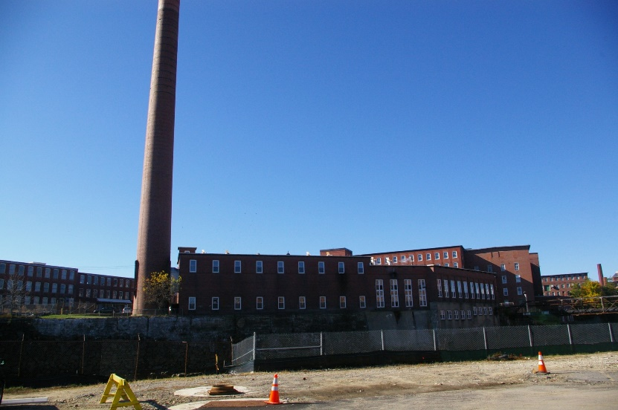
Why Don’t We Have Any Brownfields?
Stephen Dyer, PE
Todd Coffin, LG

Slide 2
EPA Brownfields Definition
“A brownfield is a property, the expansion, redevelopment, or reuse of which may be complicated by the presence or potential presence of a hazardous substance, pollutant, or contaminant.”
Land or buildings
Suspected contamination
Higher & better use

Slide 3
What isn’t it (usually)?
Subject to CERCLA removal action (Superfund Sites)
TSCA PCB cleanups
LUST Trust Fund cleanups (federally regulated UST facilities)
RCRA corrective actions
Subject to administrative or judicial orders/consents
Grantee owned properties (depends on acquisition)

Slide 4
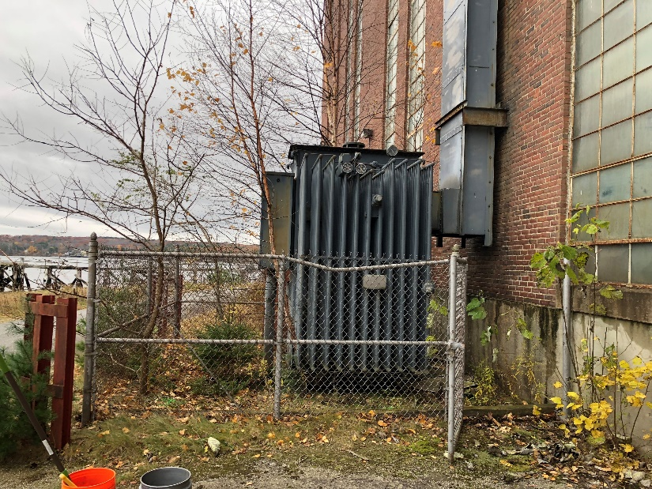
Generally, Don’t Use EPA Assessment Funds Here
Superfund Site
TSCA PCB Cleanup

Slide 5
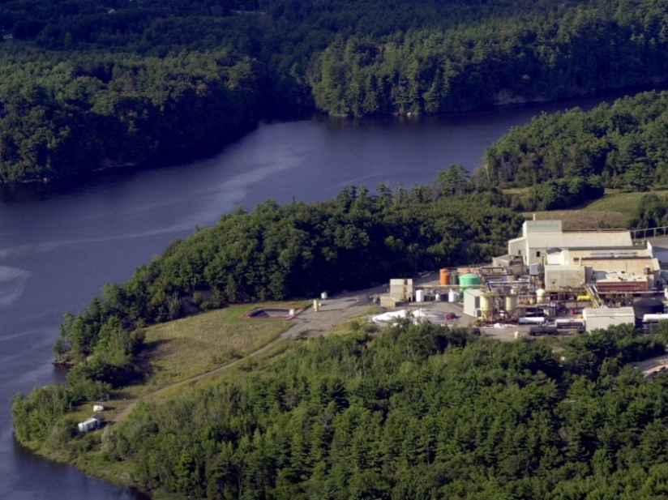
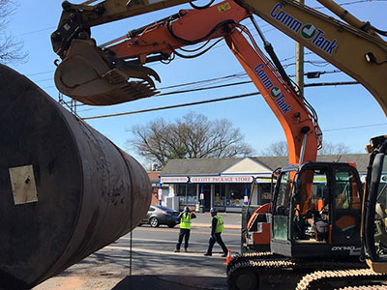
Generally, Don’t Use EPA Assessment Funds Here
RCRA Corrective Actions Site
Sites Enrolled in Federal
LUST funding programs

Slide 6
“A brownfield is a property, the expansion, redevelopment, or reuse of which may be complicated by the presence or potential presence of a hazardous substance, pollutant, or contaminant.”

Slide 7
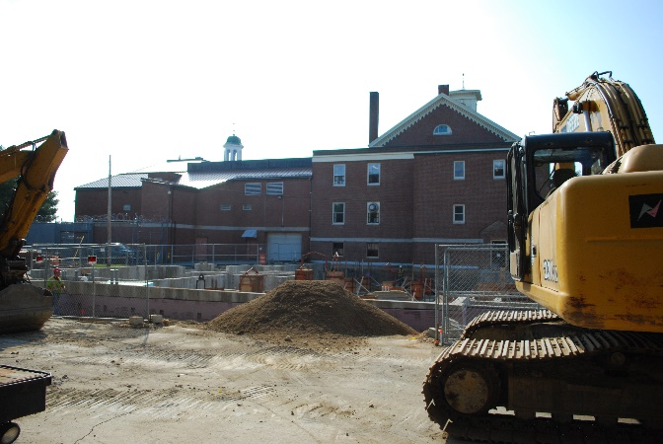
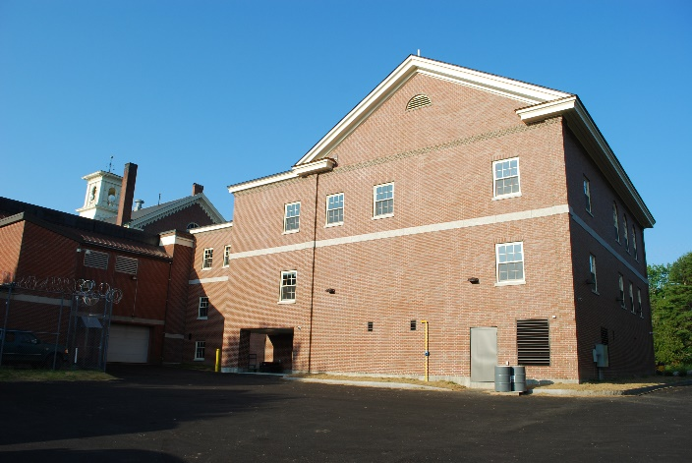
…expansion
Washington County Courthouse (Machias)

Slide 8
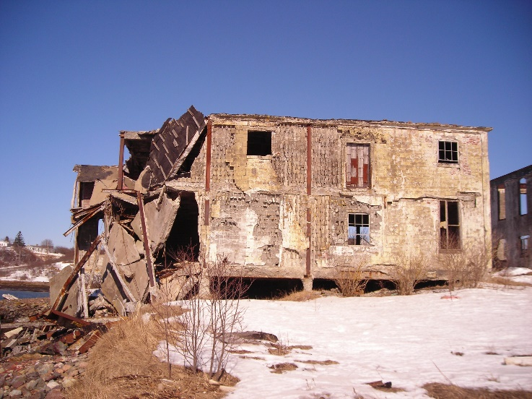
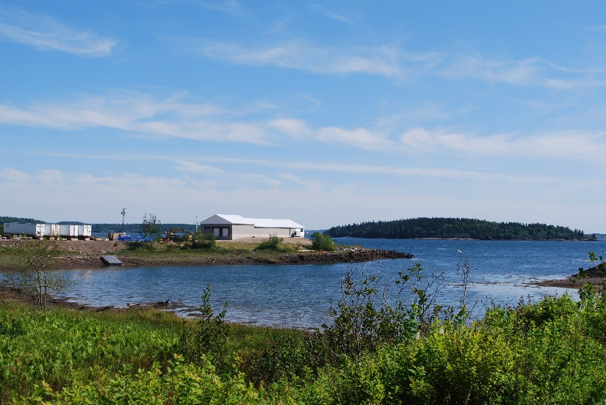
…redevelopment
Lighthouse Lobster & Bait (Eastport)

Slide 9
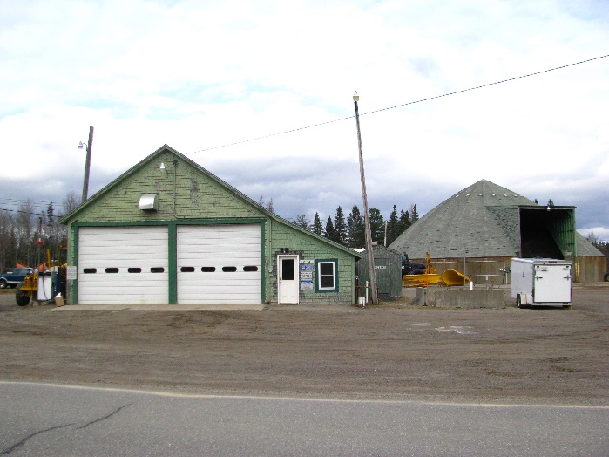
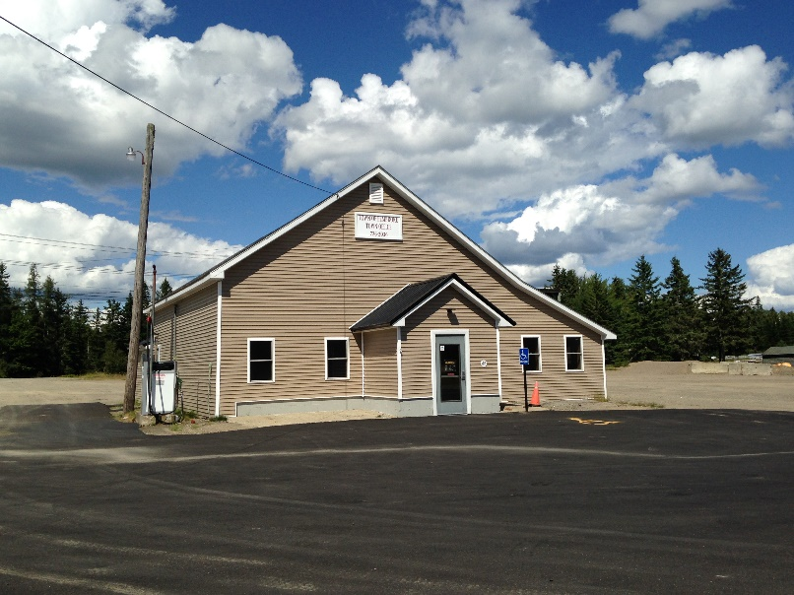
…reuse
Town Office (Pembroke)

Slide 10
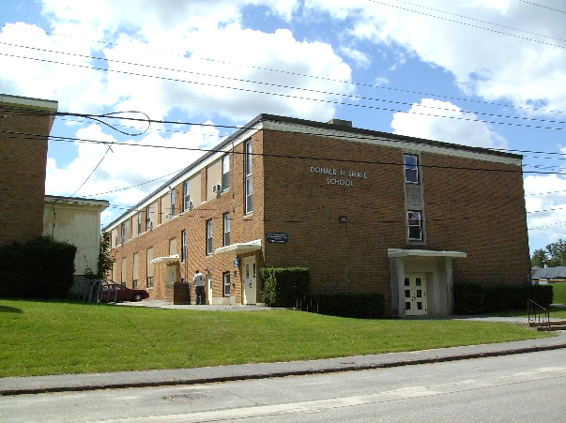
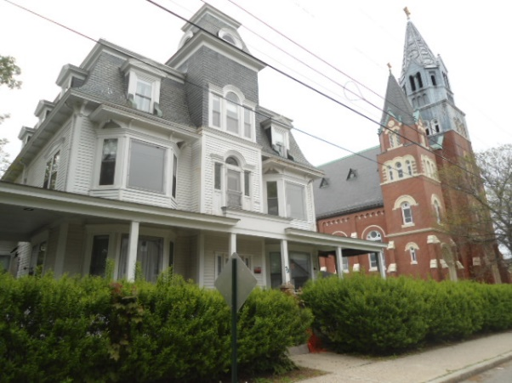
Brownfields in your Community
Schools
Churches
Donald M. Small School (Bath)
St. Andres Church & Rectory (Biddeford)

Slide 11
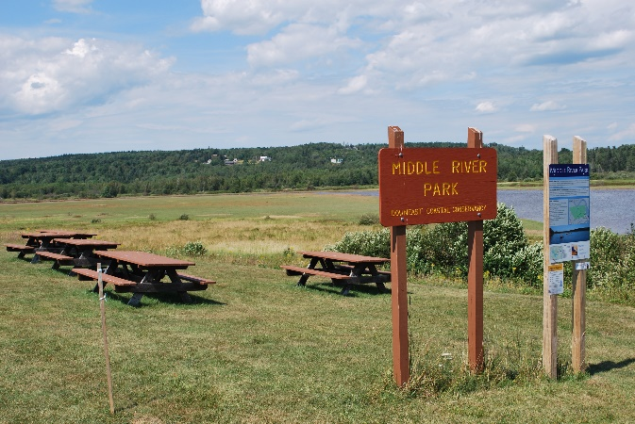
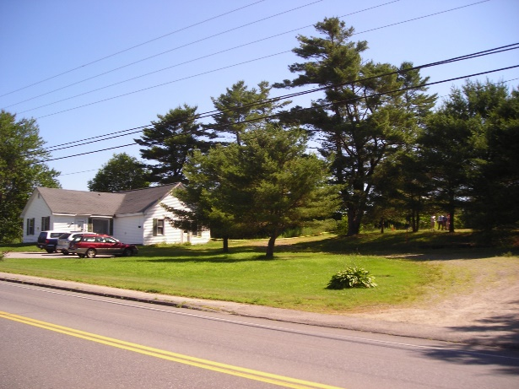
Brownfields in your Community
Recreational Space
Foreclosure Property
Middle River Park (Machias)
Residence (Wiscasset)

Slide 12
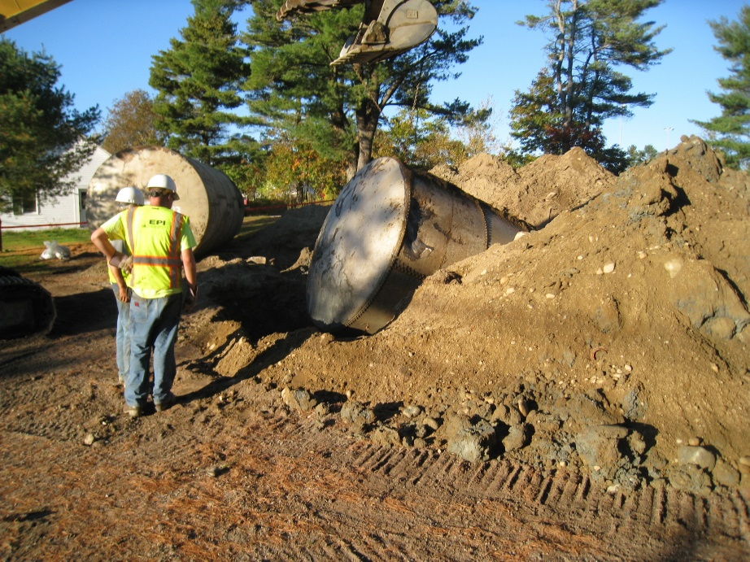
Brownfields in your Community

