Slide 1
Essential Topics in ELA
What, Why, and How

Slide 2
Tools we will use today
Waterfall
Stamping
Jamboard
Notes:
Let's make sure you know how to use the tools

Slide 3
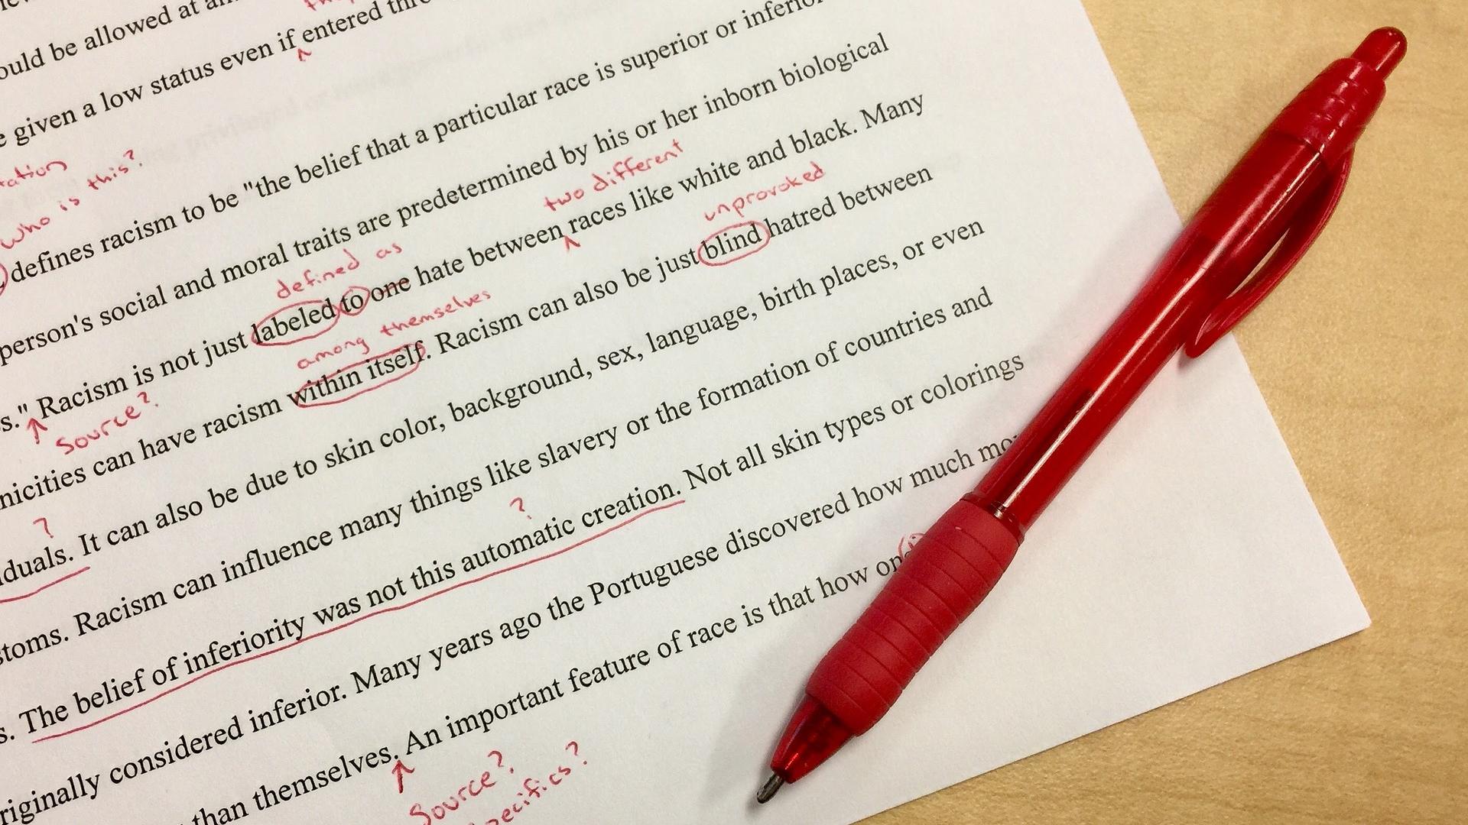
2020 Maine ELA Standards
Revised from previous standards: Common Core State Standards
Not created from scratch
Notes:
Implementation of the 2020 standards should be much simpler than what has happened before. The standards are familiar. It’s the interpretation that needs work! Let’s see if I can convince you.
https://owl.excelsior.edu/wp-content/uploads/sites/2/2018/09/mistakes-1756958_1920.jpg

Slide 4
Introduction
Seriously slimmed from CCSS
Describes overall goal/purpose of ELA standards
Includes Guiding Principles with ELA connections

Slide 5
Today’s learners need to know how to read, write, speak, and communicate effectively in order to survive in an ever-changing and challenging global society.

Slide 6
Today’s learners need to know how to read, write, speak, and communicate effectively in order to survive in an ever-changing and challenging global society.
Notes:
We often approach literacy instruction as just reading, writing, and speaking.

Slide 7
Today’s learners need to know how to read, write, speak, and communicate effectively in order to survive in an ever-changing and challenging global society.
Notes:
To be ready for how life works today, effective communication is an essential literacy requires us to think differently about the role of reading, writing, and speaking.

Slide 8
Today’s learners need to know how to read, write, speak, and communicate effectively in order to survive in an ever-changing and challenging global society.
Notes:
It is a matter of survival.

Slide 9
Today’s learners need to know how to read, write, speak, and communicate effectively in order to survive in an ever-changing and challenging global society.
Notes:
In the chat, note something you have done in the last 24 hours that demonstrates effective communication that is not JUST reading, writing, and speaking.

Slide 10
Essentials of 21st Century Literacy
English Language Arts/Literacy is the foundation for learning in all of the content areas.
The literacy continuum develops across an individual’s lifetime, but literacy does not reside solely in the individual person; it requires and creates relationships with others through communication and interaction.
Notes:
Use a stamp to indicate a word of critical importance in this statement.

Slide 11
Guiding Principles - ELA
Clear and effective communicator: Students participate in a range of evidence-based discussions and generate detailed writing that are both used to communicate ideas clearly with others.
A self-directed and lifelong learner: Students apply knowledge in new contexts and demonstrate flexibility including the ability to learn, unlearn and relearn.
Notes:
The Guiding Principles are incorporated into the standards with a description of how they relate specifically to the content. Each content area is doing this in some form. Learning transfer, the ability to transfer learning from a familiar context to an unfamiliar context, is critical to being a self-directed and lifelong learner.

Slide 12
Summarize in a single sentence.
Notes:
We will use the waterfall technique to summarize what I have presented so far. What is one big idea in the introduction to the 2020 ELA standards? https://unsplash.com/photos/waAAaeC9hns
We will continue with a closer look at some of the essential topics in ELA.

Slide 13
The Language standards are in the first position.

Slide 14
Preamble to Language
While the language standards are presented separately from reading, writing, speaking, and listening, they are best utilized and presented as embedded skills within the other strands.
These standards are not a checklist, but key components of reading, writing, speaking, and listening instruction, and they should be treated as such.
Frequent, intentional reference to and instruction in these skills is essential to teaching students to be clear communicators in every medium and field.
Notes:
How do these ideas connect to the general ELA introduction?

Slide 15
Knowledge of Language
Apply knowledge of language to understand how language functions in different contexts, to make effective choices for meaning or style, and to comprehend more fully when reading or listening.
Apply knowledge of language to understand how language functions in different contexts, to make effective choices for meaning or style in writing and speaking, and to comprehend more fully when reading or listening.
Notes:
Why is this subtle change significant? This very subtle change helps to clarify the relationship of language development in both input (reading and listening) and output (writing and speaking).

Slide 16
Knowledge of Language 6-8
Vary sentence patterns for meaning, reader/listener interest, and style.
Maintain consistency in style and tone.
Choose language that expresses ideas precisely and concisely, recognizing and eliminating wordiness and redundancy.
Use verbs in the active and passive voice and in the conditional and subjunctive mood to achieve particular effects (e.g., emphasizing the actor or the action; expressing uncertainty or describing a state contrary to fact).
Notes:
What needs to be present in the texts students are reading to provide a teachable moment and learning opportunity?

Slide 17
Knowledge of Language 6-8: Close Reading
Vary sentence patterns for meaning, reader/listener interest, and style.
Sentence patterns:
Highlight end marks
Highlight internal punctuation in a different color
Underline verbs
Opportunities
Active or passive verbs
Verbs that aren’t verbs at all!
Ways of making long sentences

Slide 18
Uncommon punctuation: colon
I liked his smell: it was of leather, horses, cottonseed.
I liked his smell.
It was of leather, horses, cottonseed.
Use a colon between two independent clauses when the second explains or illustrates the first.

Slide 19
Uncommon Punctuation: Dashes
“Then you just pretend you’re half—? I beg your pardon, sir,” I caught myself. “I didn’t mean to be—”
EN DASH: shorter length. Used to mark ranges
EM DASH: longer length. Use to separate extra information or mark a break in a sentence.
Do not confuse dashes with hyphens.

Slide 20
Teach language use as close reading
Circle relationship words: conjunctions, prepositions
These will indicate phrases and clauses
Deconstruct then reconstruct
Notes:
We often begin this instruction of teaching sentences combining when working on writing feedback and edits. To start with reading, we need to find texts that have the elements we want to teach. Teaching students to recognize relationship words and how sentences are constructed using them helps struggling students and language learners. It also helps students make meaning of complex texts and transfer that learning to unfamiliar texts.
https://unsplash.com/photos/CeGP3MkcnxA

Slide 21
Why language use matters
Language is the basis for understanding TEXT COMPLEXITY

Slide 22
2020 ELA Standards
Grades 6, 7, 8 now 6-8 like all other content areas
Grades 9-10 and 11-12 now 9-diploma like all other content areas
This is why text complexity matters!
Notes:
To “unpack” the 6-8 and 9-12 standards, there needs to be a significant understanding of what text complexity is and how to use it appropriately in the classroom.

Slide 23
A Closer Look
Essential topics to implement the standards:
relationship

Slide 24
Relationships among the standards
Speaking and Listening updates
SL.3 Present information and supporting evidence appropriate to task, purpose, and audience so that listeners can follow the line of reasoning and incorporate multimedia when appropriate.
Writing
W.3 Routinely produce a variety of clear and coherent writing in which the development, organization, and style are appropriate to task, audience, and purpose.

Slide 25
Compare these two standards
Presentation of Knowledge and Ideas
Present information and supporting evidence appropriate to task, purpose, and audience so listeners can follow the line of reasoning and incorporate multimedia when appropriate.
Composing for Audience and Purpose
Routinely produce a variety of clear and coherent writing in which the development, organization, and style are appropriate to task, audience, and purpose while avoiding plagiarism.
Notes:
These two standards address presenting and writing. What is the common learning that we want students to demonstrate?

Slide 26
What is common?
Present claims and findings, emphasizing salient points in a sequenced, focused, coherent manner with relevant evidence, sound and valid reasoning, and well-chosen details.
Address alternative or opposing perspectives; the organization development, substance, and style are appropriate to purpose, audience, and a range of formal and informal tasks.
Develop and support the topic with relevant techniques and logically ordered details.
Effectively use increasingly complex and precise language to establish an appropriate voice and tone.
Compose clear and increasingly varied and complex pieces with purposefully designed sections that are organized to fully explore the depth and significance of ideas that are appropriate to task, audience, and purpose.
Vary syntax for effect, consulting references for guidance as needed; apply an understanding of syntax to the study of complex texts when reading.
Notes:
Let’s read these in order. Describe the relationship between and among these six standards.

Slide 27
How do you teach these learning targets separately?
Notes:
https://unsplash.com/photos/7kSnMLGoR9w

Slide 28
Braided ELA Instruction
Notes:
Braided instruction intentionally weaves together standards from different strands and from various disciplines to better understand the connectedness of learning and create the conditions for learning transfer. Braided instruction also provides far more opportunities to elevate the learning – on a Bloom’s scale, a Webb scale, a Marzano scale, or whatever measure you use.

Slide 29
Explicit and implicit digital and media literacy development
communicate effectively in order to survive in an ever-changing and challenging global society.
Successful students must be able to communicate in multiple mediums, through conversations, interviews, digital presentations, and countless day-to-day interactions that build understanding of their world and the perspectives of their peers.
A text is anything that can be read, heard or viewed. Texts may include words, images, objects, sounds, and symbols that convey messages from developers to consumers.
frequently read, evaluate, and synthesize information and ideas from multiple sources, incorporating it into both oral and written communication.
Notes:
Stamp any EXPLICIT statements of digital or media literacy. Clear. Stamp any IMPLICIT expectations of digital or media literacy.

Slide 30
Digital and Media Literacy Development
Notes:
Many states updated the CCSS by creating a digital literacy or media literacy strand. Maine teachers felt these skills are so embedded in current instruction and life that they can’t be separated.

Slide 31
DEI
communicate effectively in order to survive in an ever-changing and challenging global society.
Key to success in our modern world is interaction with diverse others and ever-changing groups, and creating and following community guidelines and rules, which is a critical practice for civic responsibility later in life.
demonstrate ethical behavior, particularly during the discussion of ideas, maintaining awareness of, and respect for, multiple and diverse perspectives.
Analyze and evaluate how authors from various contexts (e.g. diverse, intersectional, multicultural, religious) use perspective and purpose to shape the intended content, style, and effect of various texts.
Notes:
Each of these sentences is from the ELA standards document. What, then, might be the approach to DEI in the ELA classroom? How do the braided strands support DEI in ELA?

Slide 32
Equity, Inclusion, and Culturally Responsive Pedagogy
Notes:
We are choosing to approach DEI in ELA as equity, inclusion and culturally responsive pedagogy.

Slide 33
What excites you? What concerns you?
Notes:
I am going to send you into rooms to chat for a few minutes. Use a jam board to record ideas. Use sticky notes to respond. https://jamboard.google.com/d/1kTsXIWp330wH8YwnWyj2A2CHVz0z6QZi3oGRt43ZlzM/edit?usp=sharing
https://images.unsplash.com/photo-1586806974856-c55e8b9364e4?ixid=MnwxMjA3fDB8MHxwaG90by1wYWdlfHx8fGVufDB8fHx8&ixlib=rb-1.2.1&auto=format&fit=crop&w=870&q=80

Slide 34
TO DO

Slide 35
TO DO

Slide 36
TO DO

Slide 37
TO DO

Slide 38
TO DO
Mark these sites
https://www.maine.gov/doe/learning/content/ela
https://www.maine.gov/doe/learning/content/ela/standards
https://www.maine.gov/doe/learning/content/ela/prolearning

Slide 39
TO DO
Contact
morgan.Dunton@maine.gov
or
Danielle.M.Saucier@maine.gov
with questions or for more support.
Notes:
https://images.unsplash.com/photo-1613963931023-5dc59437c8a6?ixid=MnwxMjA3fDB8MHxwaG90by1wYWdlfHx8fGVufDB8fHx8&ixlib=rb-1.2.1&auto=format&fit=crop&w=2069&q=80

