Slide 1
Reading in high school
Helping all students engage with complex texts
Notes:
Redefine text as “source”

Slide 2
Goals for Series
Understand the similarities and differences of reading instruction in high school and in the lower grades
Learn strategies to help students engage with complex texts in any context
Develop instructional plans to address a variety of student needs
Notes:
Many strategies for teaching reading are developed for the lower grades. It is essential to help students engage with complex texts and not to replace complex texts with simplified versions. Most important is the need to develop consistent, unified plans to address needs in each content area.

Slide 3
Topics in session 1
Research: what works and what really doesn’t work?
What is complex text? Why does it matter?
How do Maine’s updated ELA standards reflect both research and experience of Maine teachers?
Text types
Content contexts

Slide 4
Research About Reading
Is High School Really Different?

Slide 5
Reading for Understanding Initiative
Begun in 2010 – a research project to determine what works and suggest policy to support effective practices
Resulted in a Symposium to share findings in 2016
What works depends on context
Notes:
There are some programs that work for early elementary reading development. These include specific structures and elements of progression. Once we get past phonemic instruction and basic reading skills, there are few programs that improve student reading. Instead, direct instruction of complex text elements is what has proven to be the most helpful.

Slide 6
Policy
You can download the report with suggestions for policy development
From CCSSO and ETS

Slide 7
RfU: Key Findings - Vision
It is essential to create a shared vision of reading literacy proficiency
We must overcome a multitude of prejudices
We must each be willing to make compromises
We must understand the place of reading literacy proficiency in the wider world

Slide 8
RfU Findings - goals
We must constantly evolve our understanding of reading literacy in the twenty-first century
Consider the rate of technological and social change in the digital age
Anticipate that the nature of reading may be quite different a decade from now – when many of our students are making their way in the world
Reading literacy is necessary to make decisions and solve problems
Much daily communication is done electronically

Slide 9
Maine’s Updated ELA Standards
How they reflect research and practice

Slide 10
CCSS Reading Standards
LITERARY TEXTS | INFORMATIONAL TEXTS | HISTORY/SS TEXTS | SCIENCE/TECHNICAL TEXTS
Grade level standards described specific requirements for reading and analyzing literature | Grade level descriptors examined informational reading, though mostly focused on literary nonfiction | Describes reading of texts typically found in history and social studies classes | Describes reading of texts typically found in science and technical subject classes
The purpose of the CCSS authors was to distribute responsibility of reading instruction by fine tuning the differences between and among the subject areas.
This intention was rarely understood.

Slide 11
Maine’s Updated Reading Standards
Literary | Informational | History/SS | Science/technical
Becomes simply reading.
Refocuses the development of reading skills on the key concepts regardless of text type or genre.
Provides greater flexibility for instruction and assessment.

Slide 12
Small Group Discussion
How do the changes to Maine's reading standards reflect the evolving nature of reading literacy development?
How might this impact your classroom?

Slide 13
RfU: Six Critical Aspects of Reading
All reading activities should have an overarching purpose
Reading too narrowly (for instance, to find a date) requires only scanning
An overarching purpose defines what sources and information are important

Slide 14
RfU: Six Critical Aspects of Reading
2. Reading activities should require students to integrate information from reading multiple sources
Finding the answer to a complex situation requires synthesis of much information to form an entire picture
Many answers cannot be found in a single source

Slide 15
RfU: Six Critical Aspects of Reading
3. Students should read both reliable and unreliable sources to develop critical thinking and evaluation skills.
When information conflicts, students must be able to determine what is relevant to the topic or question
Readers must be able to resolve the discrepancies

Slide 16
RfU: Six Critical Aspects of Reading
4. Reading must not be restricted to traditional text but should also include a broad variety of digital sources
The definition of “reading” must evolve to include all the potential sources of information
Reading in different contexts requires different stances – there is not a one-size-fits-all reading strategy, but many for various situations

Slide 17
RfU: Six Critical Aspects of Reading
5. Reading is a dynamic activity
Teaching students to skim, read, and read again for a different reason is essential
Readers must monitor understanding and regulate behavior to achieve coherence across a text or multiple texts

Slide 18
RfU: Six Critical Aspects of Reading
Reading activities should require social interaction
Accountable talk inspires perspective-taking and appreciation for diverse perspectives
Developing shared understanding is a key social aspect of reading for understanding

Slide 19
STRENGTH OR STAMINA
Literacy strength is the ability to engage with complex texts.
Literacy stamina refers to the ability to read independently for a sustained period.
It is essential to know how to build both strength and stamina when planning literacy instruction.
Today, we are doing to focus on building strength.

Slide 20
Text Complexity
What it is and
why it matters

Slide 21
We are all struggling readers - sometimes
When are you a struggling reader?

Slide 22
Ignition Component Renewal
As with spark plugs, the distributor cap, rotor and spark plug wires are all part of your vehicle’s ignition system. The distributor cap accepts all the spark plug wires and is part of the system that distributes gas-igniting sparks to different engine cylinders as needed. The ignition rotor (not to be confused with a brake rotor) sits inside the distributor cap and is responsible for the direction of electricity to the various contacts within the distributor cap. Spark plug wires need to be replaced less often than the distributor cap and rotor.
Notes:
From the Family Handyman: How to tune up a car

Slide 23
Kyivan (Kievan) Rus
The formation of the Kyivan state that began in the mid-9th century, the role of the Varangians (Vikings) in this process, and the name Rus by which this state came to be known are all matters of controversy among historians. It is clear, however, that this formation was connected with developments in international trade and the new prominence of the Dnieper route from the Baltic to Byzantium, on which Kyiv was strategically sited. Trade along this route was controlled by Varangian merchant-warriors, and from their ranks came the progenitors of the Kyivan princes, who were, however, soon Slavicized. In the early chronicles the Varangians were also called Rus, and this corporate name became a territorial designation for the Kyivan region—the basic territory of the Rus; later, by extension, it was applied to the entire territory ruled by members of the Kyivan dynasty.
Notes:
From the History of Ukraine on Wikipedia

Slide 24
At first the mist was so pervasive that she could see nothing else, until slowly she saw pillars appear on either side of her. She was standing on a path, some kind of colonnade. The columns were brain-grey, with specks of brilliant blue. The misty vapours cleared, like spirits wanting to be unwatched, and a shape emerged.
A solid, rectangular shape.
The shape of a building. About the size of a church or a small supermarket. It had a stone facade, the same colouration as the pillars, with a large wooden central door and a roof which had aspirations of grandeur, with intricate details and a grand-looking clock on the front gable, with black-painted Roman numerals and its hands pointing to midnight. Tall dark arched windows, framed with stone bricks, punctuated the front wall, equidistant from each other. When she first looked it seemed there were only four windows, but a moment later there were definitely five of them. She thought she must have miscounted.
Notes:
From the Midnight Library by Matt Haig

Slide 25
TEXT COMPLEXITY
How complex are these three excerpts?
What makes them complex?

Slide 26
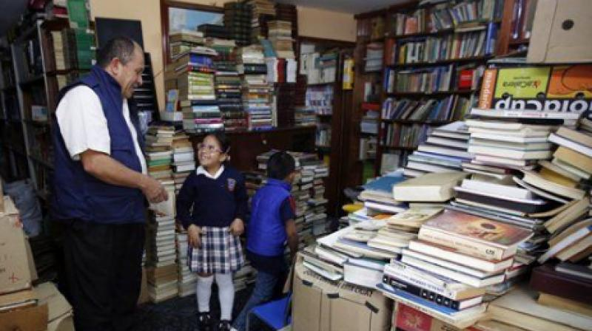
The Garbage Collector’s Library
Look at the article, but don’t read it.
Highlight the end marks.
Highlight in a different color the internal punctuation.
Start reading. Circle any words that are complex.

Slide 27
What makes a text complex?
Look at the end marks again. Estimate the average sentence length.
Consider the vocabulary you marked and determine a reading level.

Slide 28
Complexity: Take 2
Look at the second version of the garbage library article.
Highlight end marks.
Highlight interior punctuation with a different color.
Circle complex words.
Estimate the average length of a sentence.
What is the reading level of this version?

Slide 29
What is text complexity?
Why does it matter?

Slide 30
Small Group Discussion
What are the most complex resources in your classes? What makes those resources complex?

Slide 31
What you teach should inform how you teach.

Slide 32
Direct Instruction of Reading Skills
In high school, we often teach reading as a thinking exercise.
Many students would benefit from direct instruction of the type of “text” we are teaching.
Are you providing direct instruction of each type of text you teach?

Slide 33
One high need area of direct instruction in high school: expository reading and writing
Notes:
Many of us teach literature as our primary text type, but we ask students to read articles, do research or conduct mini inquiry projects and assume students will not need support to engage with the texts assigned or selected. We also have long operated on the notion that literacy instruction relative to literature will naturally transfer to other text types. This is, in fact, not necessarily true.

Slide 34
Next time
We will address direct instruction of expository reading and writing.
Please bring a colleague of the not English teacher sort☺
Notes:
Content area teachers and librarians are suggested as partners for the next session.

Slide 35
Feedback for contact hours
We will trade feedback for your contact hours. Please complete this form and download the certificate you receive after.

