Slide 1
Using Maine Integrated Youth Health Survey Data
Presentation Created in 2016

Slide 2
MIYHS Background
The Maine Integrated Youth Health Survey (MIYHS) is a comprehensive youth health survey administered in February of odd years. It is used to gauge the health and health habits of Maine’s public school students.
The survey covers the following topics:
Alcohol, tobacco and drug use
Bullying
Sexual health
Injury (intentional and unintentional)
Physical activity and nutrition
Mental health
Protective factors (self confidence, perception, supports, assets)
Grades

Slide 3
MIYHS Presentation Overview
Data analysis can be a complex process especially with large survey instruments like the MIYHS.
This presentation aims to simplify and define important strategies, terms and statistical methods needed to use the data effectively.
Presentation Content
Using the MIYHS data
Examples of effective ways to involve the data in your work
Confidence Intervals:
The term “Confidence Interval” is defined clearly and shown in two examples.
Correlation vs. Causation
Take Caution! other key analysis pointers
Contact

Slide 4
Applying the MIYHS data
Some ways the MIYHS data can be used:
Help support the need for a new or updated policy
Start or continue conversations that will reveal opportunities for collaboration between partners (Engage partners on topics they care about)
Open doors to work with new youth or parent groups
Strengthen ability to apply for further funding (Use the data to determine and show the need)
Start conversations about bringing evidence-based programs into schools
Raise community awareness on local strengths and weaknesses such as:
Create opportunities to “dig deeper” into the data with focus groups or group interviews about topics of interest.
A town monthly newsletter that highlights events and opportunities.

Slide 5
Confidence Intervals: Defined
Survey Year
2013 | 2015
For all surveys, the reported percentage is an estimate & has some statistical error.
This is error is accounted for by the Confidence Interval (C.I.):
a range defined by: the Lower Confidence Limit (LCL) & the Upper Confidence Limit (UCL).
If this survey was done 100 times, the results would fall within the LCL & the UCL 95 times.
The 5 times the results fall outside of these ranges is due to random error; which cannot be completely eliminated.
When comparing data for “significant change”, Confidence Intervals should always be used.

Slide 6
Confidence Intervals: Example No Significant Change
Survey Question: During the past 30 days, on the days you smoked, how many cigarettes did you smoke per day?
2013
Showing HS Students who answered:
10 or more cigarettes per day
2015
Survey Year
2013 | 2015
By comparing the Confidence Interval of this data point in 2013 and 2015; it can be seen that there is an overlap between the C.I’s.
This means there is no statistically significant difference between the percent of high school students who reported smoking 10+ cigarettes per day in 2013 & the percentage in 2015.

Slide 7
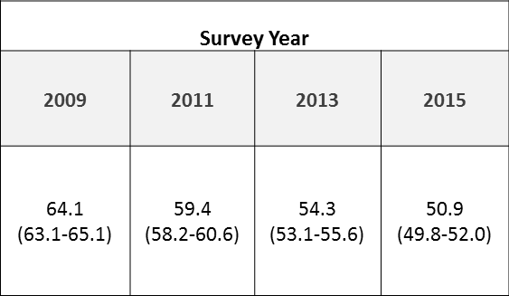
Confidence Intervals: Example Significant Change
Survey Question: During your life, how many days have you had at least one drink of alcohol?
2015
2013
2011
2009
Showing HS Students who answered: At least 1 day
By comparing each Confidence Interval of this data point from: 2009, 2011, 2013, and 2015, it can be seen that there is no overlap between the C.I.’s.
This means there has been a statistically significant decrease in Maine high school students who reported drinking alcohol at least once since 2009.

Slide 8
Correlation Does Not Equal (≠) Causation
Correlation: When two or more things have some type of relationship.
Causation: A relationship of cause and effect.
A correlation between data points does not necessarily mean causation.
Example:
Of those students who reported receiving “mostly D/Fs” in 2013, 48% have also reported using alcohol in the past 30 days.
While this data indicates a correlation between teen alcohol use & poor academic performance, it cannot be said that alcohol use causes poor academic performance.
More information at: https://data.mainepublichealth.gov/miyhs/files/2013SpecialReports/GradesHealthfact.pdf

Slide 9
Take Caution! Things to watch for while using MIYHS Data
Changes to the questions (i.e. Marijuana use “regularly” vs. “2-3 times a week”):
Over time, the MIYHS has modified questions as needed to keep them accurate and relevant to changing brands, behaviors, substances, etc.
Only compare questions not been marked as “moderate” or “major” modifications on the “MIYHS Modified Variable Document” to avoid comparing apples to oranges. (https://data.mainepublichealth.gov/miyhs/files/methodology/MIYHSModifiedVariables2015.pdf )
Do not use data from different surveys to evaluate change over time.
Do not use data from different sources in the same study.
Notes:
Refer to methodology report on website for YRBS suggestions

Slide 10
Questions?
For any other information related to the MIYHS,
Call 207-287-5084
or go to: www.maine.gov/MIYHS

