Slide 1
MAINE DEPARTMENT OF EDUCATION
ESEA Demographics Report
Presented by: The Data Team

Slide 2
Upcoming Reports & Webinars
Report | Webinar | Open Date | Due Date
Maine Schools | 4/30 | 5/15 | 7/30
ESEA Demographics Report | 5/14 | 5/15 | 6/15
EOY Reporting | 5/21 | Open Year Round | Varying Due Dates 6/30 or 7/15
EOY Enrollment Exits | 5/28 |  | 6/30
Special Education Exit Report | 6/4 | 6/1 | 7/30

Slide 3
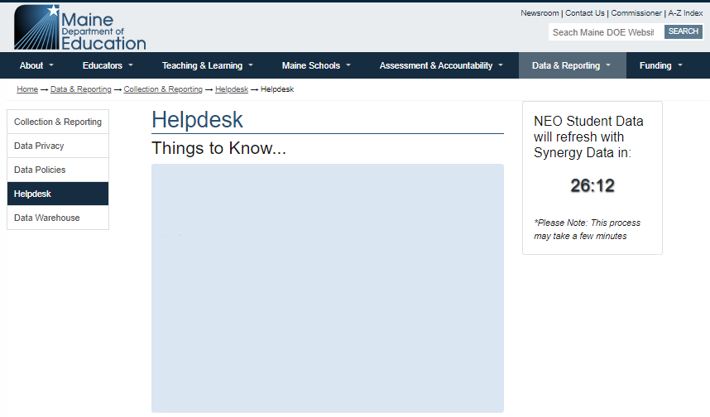
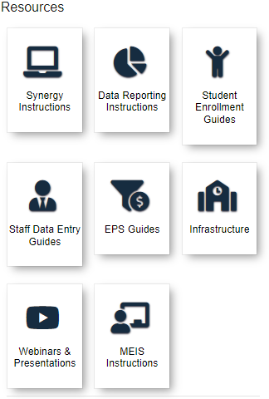
Helpdesk Website https://www.maine.gov/doe/data-reporting/collection/helpdesk
Instructions will be on the Data Reporting Instructions tile

Slide 4
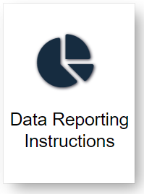
Locating Report Instructions
MEDMS Helpdesk Website
https://www.maine.gov/doe/data-reporting/collection/helpdesk
Data Reporting Instructions
ESEA Demographics Report

Slide 5
ESEA Demographics Overview
The ESEA Demographics Report is an aggregation of students enrolled on 05/27 for participation in state assessments during the current assessment administration.
This report includes student demographic categories for assessment and accountability purposes.

Slide 6
Reporting Requirements
All LEA’s with publicly funded students.

Slide 7
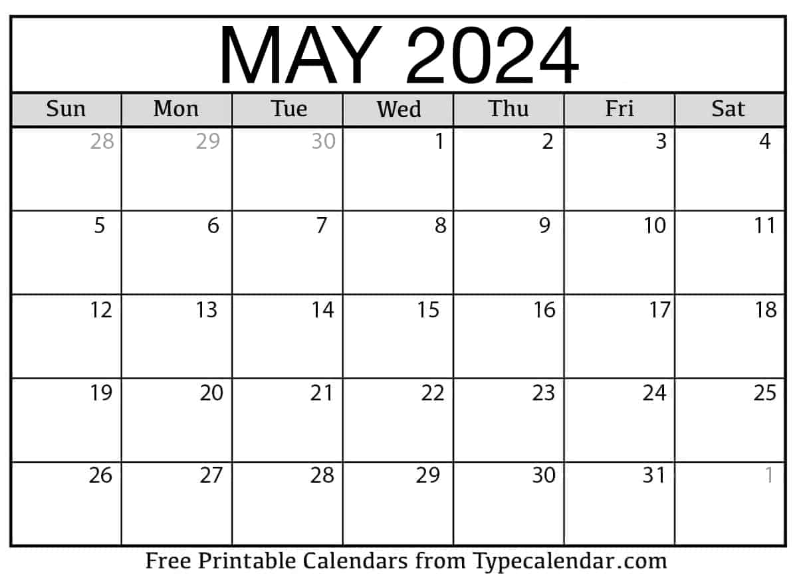
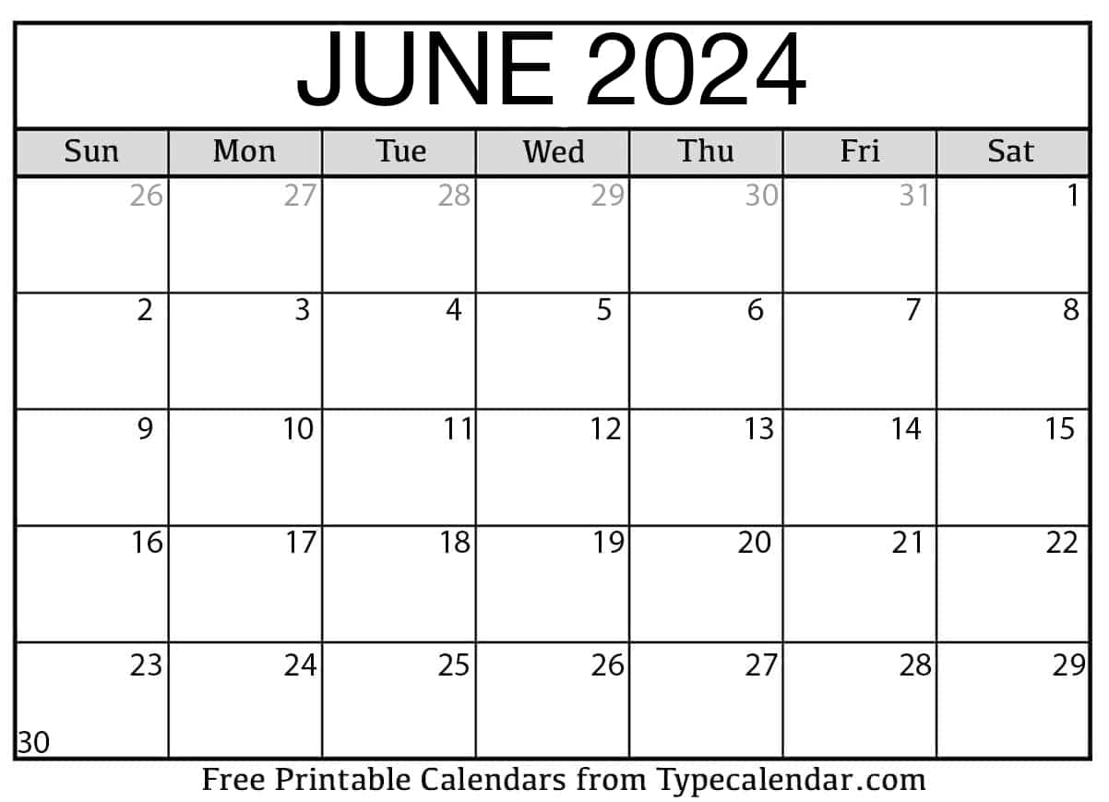
Dates
Reporting Period: 5/27/2024
Open Date: 5/15
Due Date: 6/15
Review Period: 5/15-5/27
Report Opens
Reporting Period
Report Due

Slide 8
Locating the Report
NEO Navigation steps:
NEO -> Student Data -> Student Reports-> ESEA Demographics Certification Report
Once logged into the NEO system navigate to Student Data, if you do not have NEO credentials and/or access to student reports please have your Superintendent submit a NEO Access Request Form to the DOE Data HelpDesk.
**Staff who require NEO accounts/access must be entered into NEO Staff prior to submitting an Access Request.

Slide 9
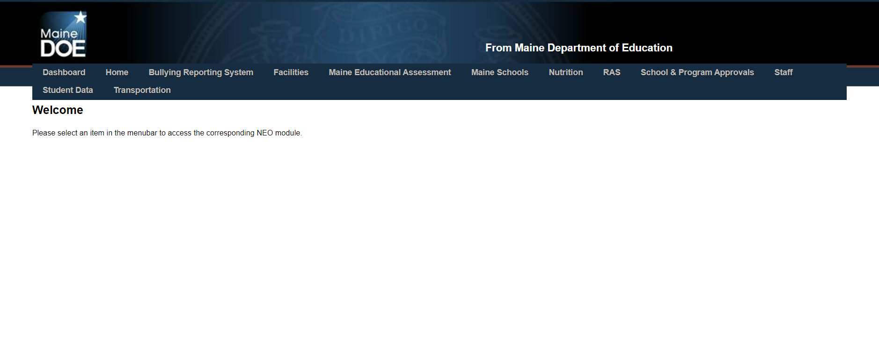
NEO Dashboard

Slide 10
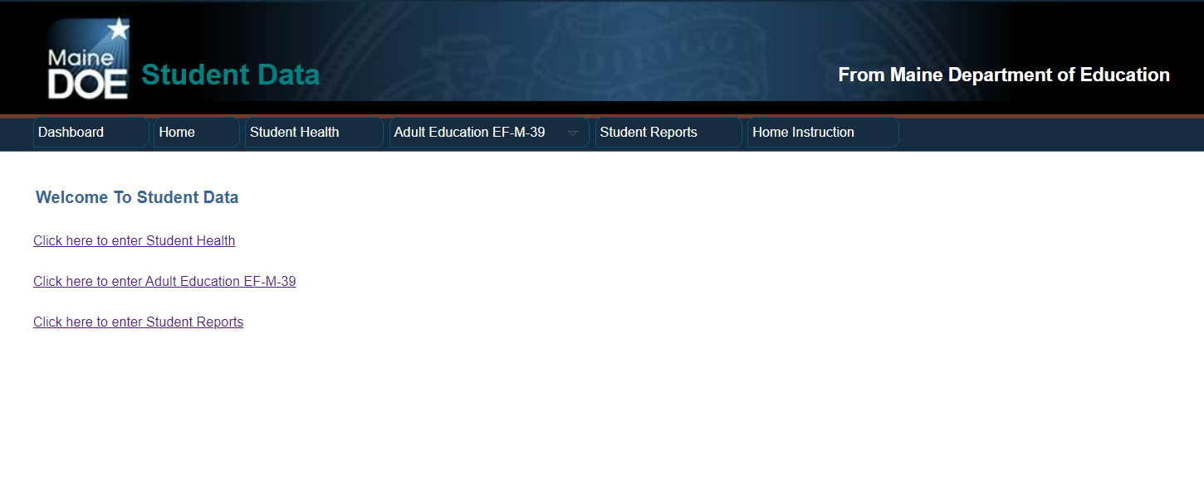
Student Data Screen

Slide 11
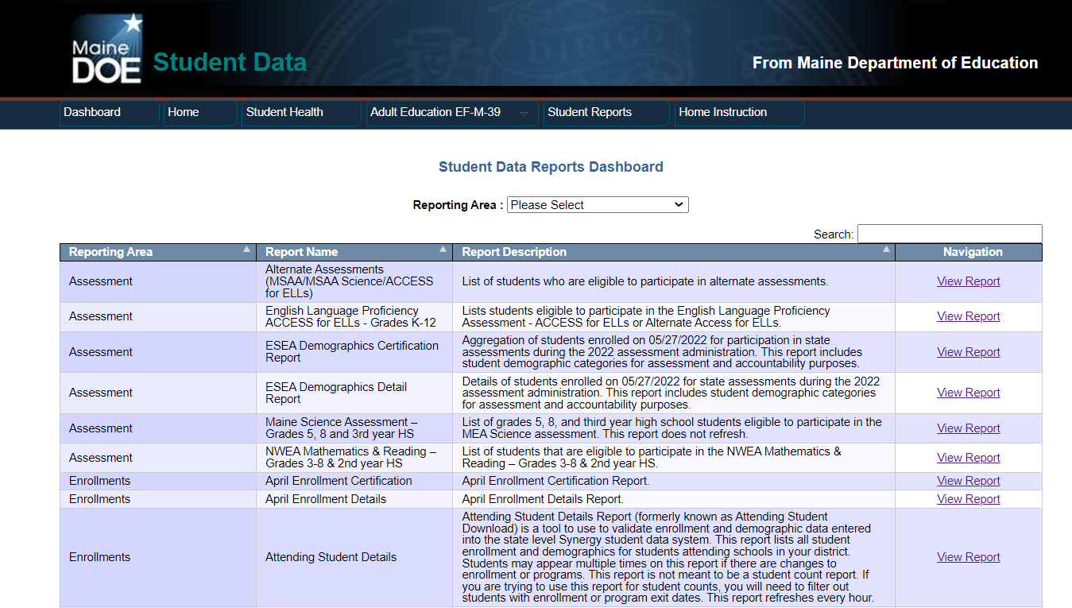

Slide 12
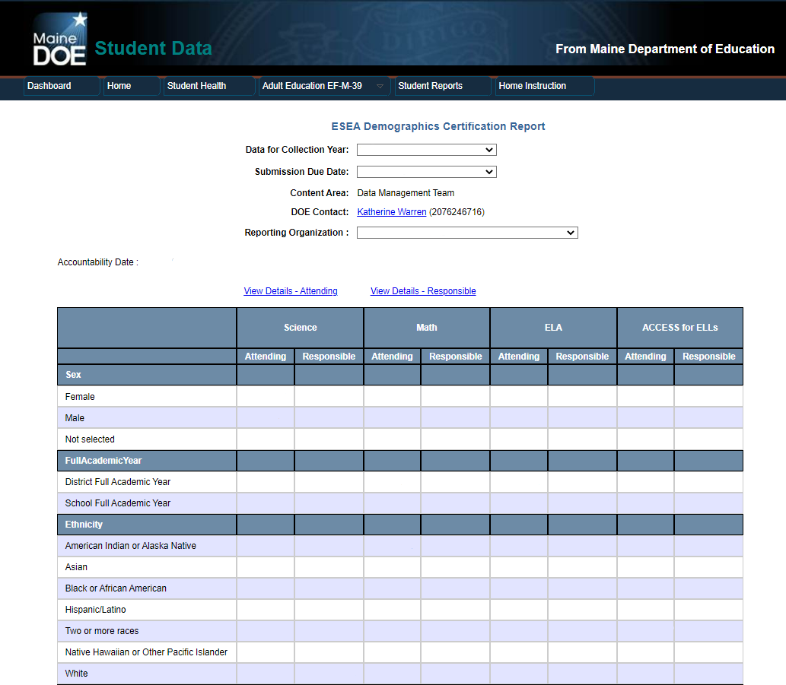
Certification Report
Link to Details Report
2023-2024
Summary of the district
Verify that all counts are accurate
Once all data has been verified, the superintendent certifies at the bottom of this report.
Rainbows and Unicorns Public Schools
2
3
4
5
4
5
0
0
1
1
3
3
3
3
0
0
0
0
0
0
0
0
0
0
0
0
0
0
0
0
0
0
0
0
0
0
0
0
0
0
0
1
0
1
0
1
0
0
SCROLL
0
0
0
0
0
0
0
0
0
0
1
1
1
1
0
0
0
0
0
0
0
0
0
0
1
0
2
2
2
2
0
0
0
0
0
0
0
0
0
0
2
3
4
4
4
4
0
0
**All Data in this presentation is staged.

Slide 13
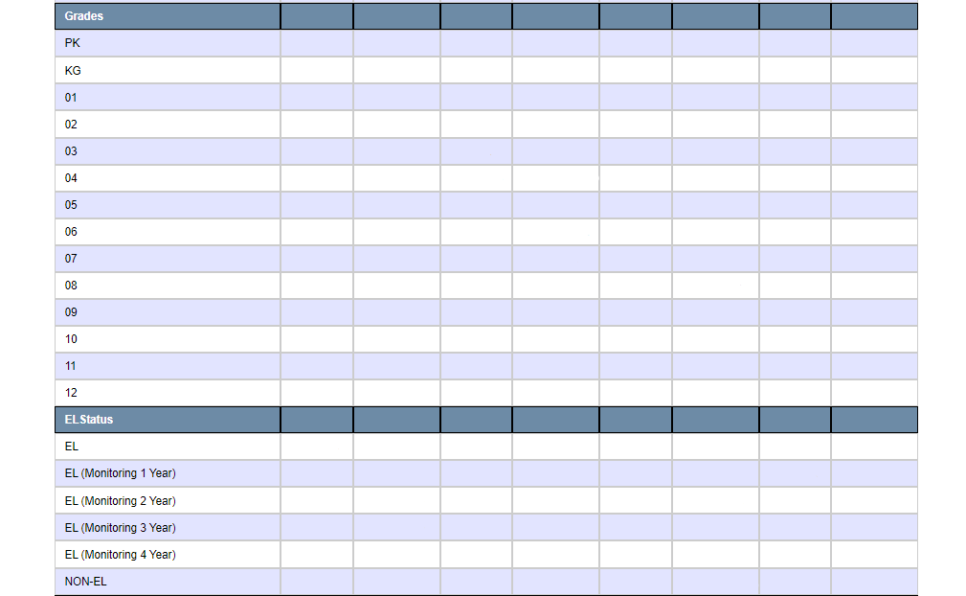
Certification Report cont.
1
1
1
1
1
1
1
1
1
1
1
1
1
1
1
1
1
1
1
1
1
1
1
2
1
2
1
2
1
1
1
1
1
1
0
0
0
0
0
0
0
0
0
0
0
0
0
0
0
0
0
0
0
0
0
0
0
0
0
0
0
0
0
0
0
0
0
0
0
0
0
0
0
0
0
0
3
4
7
8
7
8
0
0
SCROLL
**All Data in this presentation is staged.

Slide 14
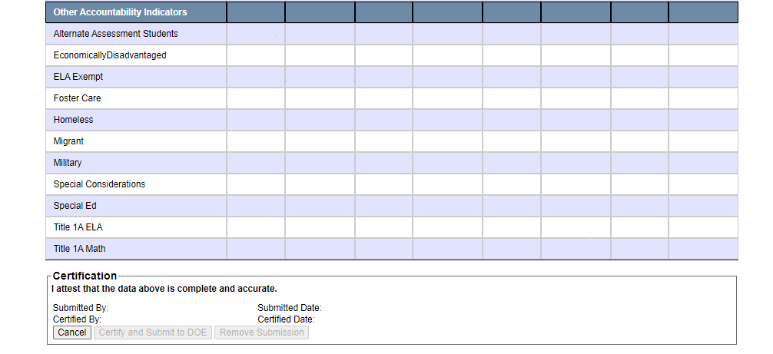
Certification Report cont.
1
2
2
3
2
3
0
0
2
3
4
6
4
6
0
0
0
0
0
0
0
0
0
0
Once all data has been verified, the superintendent certifies at the bottom of this report.
1
1
2
2
2
2
0
0
0
1
0
1
0
1
0
0
0
0
0
0
0
0
0
0
1
1
2
2
2
2
0
0
2
3
2
3
2
3
0
0
2
3
2
3
2
3
0
0
2
3
4
5
2
3
0
0
2
3
4
5
2
3
0
0
**All Data in this presentation is staged.

Slide 15
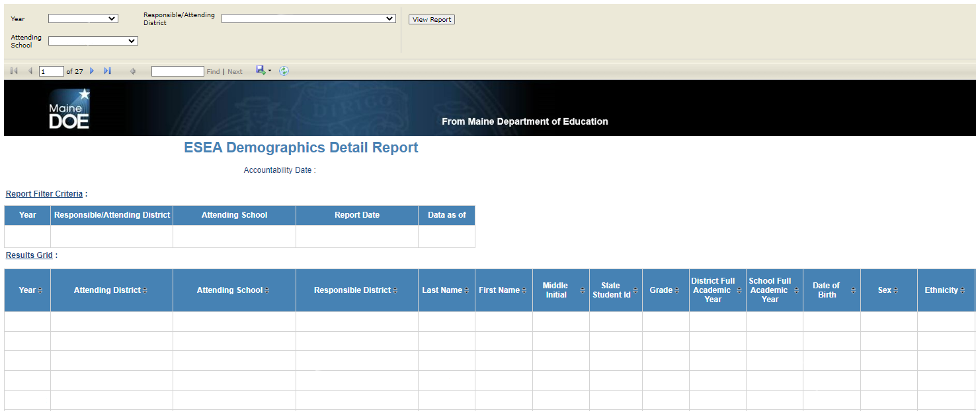
Details Report
Search
Save/Export
Column Sorting
2023-2024
Rainbows and Unicorns Public Schools
Rainbows and Unicorns
ALL
5/17/2023 9:36AM
5/15/2023 5:24PM
Rainbows and Unicorns
Elementary School
Rainbows and Unicorns
Electra
Glimmer
104852374
05
N
Y
01/08/17
Female
White
Rainbows and Unicorns
Middle School
Rainbows and Unicorns
Philippa
Buttercup
105473276
07
N
N
02/02/10
Male
White
Wonderland Regional Program
Wonderland
Rainbows and Unicorns
Andromeda
Angel
102378569
10
Y
N
06/25/07
Male
White
Rainbows and Unicorns
Elementary School
Rainbows and Unicorns
Emerald
Clover
105432689
03
Y
N
05/07/15
Female
White
Rainbows and Unicorns
High School
Rainbows and Unicorns
Cornelius
Topaz
102684365
12
N
N
04/04/04
Male
Two or More Races
**All Data in this presentation is staged.

Slide 16
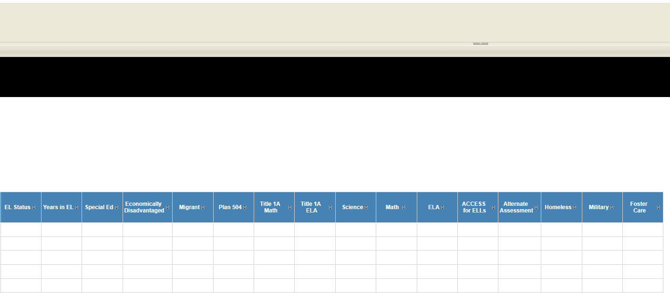
NON-EL
N
N
N
N
Y
N
*
*
*
N
N
Y
N
NON-EL
N
Y
N
N
Y
N
*
*
N
N
N
Y
NON-EL
Y
Y
N
N
N
N
*
*
Y
N
N
N
NON-EL
Y
N
N
Y
N
Y
*
*
N
N
N
N
NON-EL
N
N
N
N
N
N
*
*
N
N
N
N
**All Data in this presentation is staged.
Notes:
Asterisks mean that students are expected to participate in the assessment.

Slide 17
A few notes...
This report is only looking at students enrolled on the date of May 27, 2024
This is a Memorial Day this year; coordinate with districts for students who are moving in or out of your district over the weekend.
The total demographic counts on the certification page only include District Full Academic Year students: students continuously enrolled in the district from October 1 to May 27.
Students exited prior to May 27th will not be counted on the report.
Only the Superintendent will be able to click the ‘Certify and Submit to DOE’ button.
Notes:
Note that Synergy is where all Student Data gets UPDATED
5/15-5/27 is a review period, the report cannot be certified before 5/27

Slide 18
Get In Touch
Email
Contact Our Department
MEDMS.Helpdesk@maine.gov
Alexandra.Cookson@maine.gov
Our Sites
maine.gov/doe/data-reporting/collection/helpdesk
Phones
1-207-624-6896

Slide 19
Stay Connected!
Find Us Online!
www.maine.gov/doe
@MaineDOEComm
@mainedepted
@mdoenews
@MaineDepartmentofEducation1

